Slide 2



2021-22 CRD CONTACT SLIDE
FirstName LastName
TITLE,
DIVISION
FirstName.LastName@CompanyName.org
000-000-0000

Slide 3
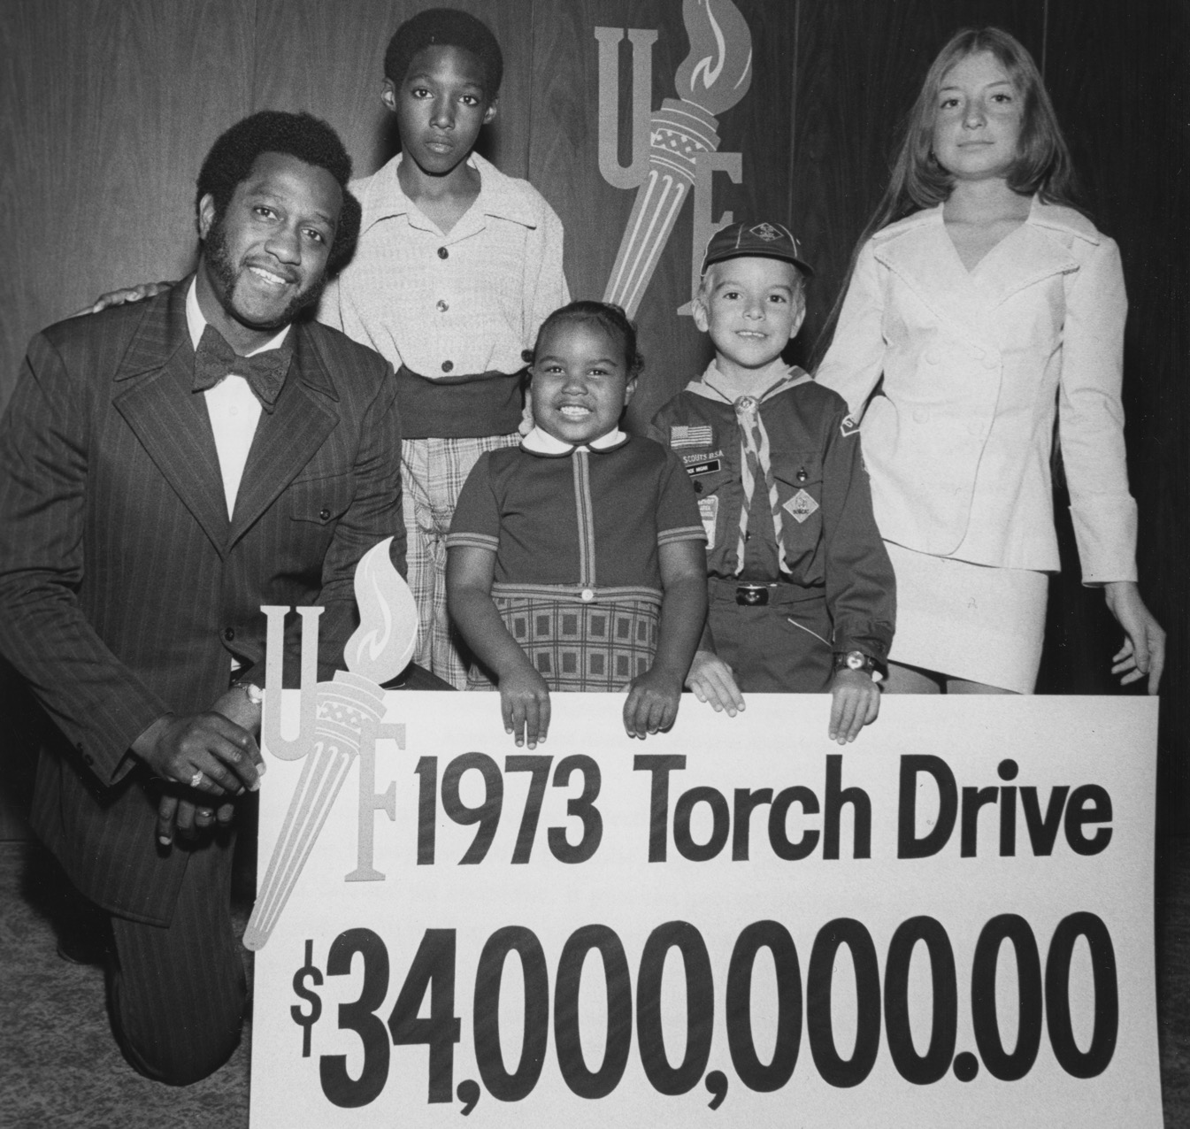
WHO
WE ARE
OUR HISTORY
OUR MISSION AND VISION
OUR VALUES
UNITED WAY WORLDWIDE

Slide 4


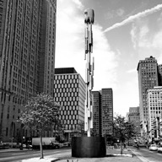
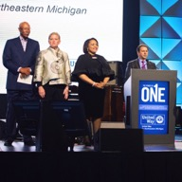


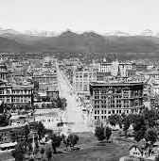




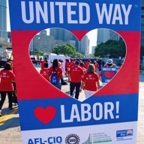

OUR HISTORY
A 60-foot metal torch is constructed and placed at 1 Woodward as a permanent symbol of the Greater Detroit campaign, and as a beacon of hope during a time of civil unrest.
Charities Organizations Society becomes the Detroit Community Union, the predecessor to United Way for Southeastern Michigan.
United Way celebrates
101 years in Southeastern Michigan!
1887
1949
2005
2021
1917
1969
2018
Denver: Religious leaders create the Charity Organizations Society, the first United Way chapter in the nation.
Detroit becomes the first major city to organize a United Way fundraising drive. A wooden torch was built to bring attention to this new workplace campaign effort.
The boards of United Way Community Services and United Way of Oakland County vote to create a new organization –
United Way for Southeastern Michigan.
United Way Worldwide celebrates 80 years of partnership with organized labor. Labor participation with United Way’s community campaign originated in Metro Detroit with the UAW.
STAND TOGETHER, LIVE UNITED: 2021-22 COMMUNITY GIVING CAMPAIGN

Slide 5




OUR MISSION
To mobilize the caring power of Detroit
and Southeastern Michigan to improve communities and individual lives in
measurable and lasting ways.
OUR VISION
Southeastern Michigan is United in building
a community of stable households and
thriving children.

Slide 6









OUR VALUES
PEOPLE-FIRST
EQUITY AND INCLUSION
COLLABORATION
INNOVATION
Community-oriented,
impact focused, accountable to households, children, stakeholders and staff.
Committed to practices that disrupt unfair systems and provide access to opportunity for all.
Focused on
continuous and
active partnerships.
Taking the lead, challenging the status quo, focused on continuous improvement.

Slide 7









UNITED WAY WORLDWIDE
1,800
LOCAL UNITED WAY
ORGANIZATIONS WORLDWIDE
United Way for Southeastern Michigan
is part of a network of nearly 1,800 community-based United Way chapters
in 40 countries and territories.
United Way SEM is an independently governed 501(c)(3) nonprofit organization.
Our chapter has its own independent board of directors, governance structure, and executive team.
40+
COUNTRIES AND
TERRITORIES
8.1 MILLION
2.9 MILLION
61 MILLION
$4.8 BILLION
DONORS WORLDWIDE
VOLUNTEERS ENGAGED
PEOPLE SERVED ANNUALLY
RAISED BY THE WORLDWIDE
MOVEMENT ANNUALLY

Slide 8
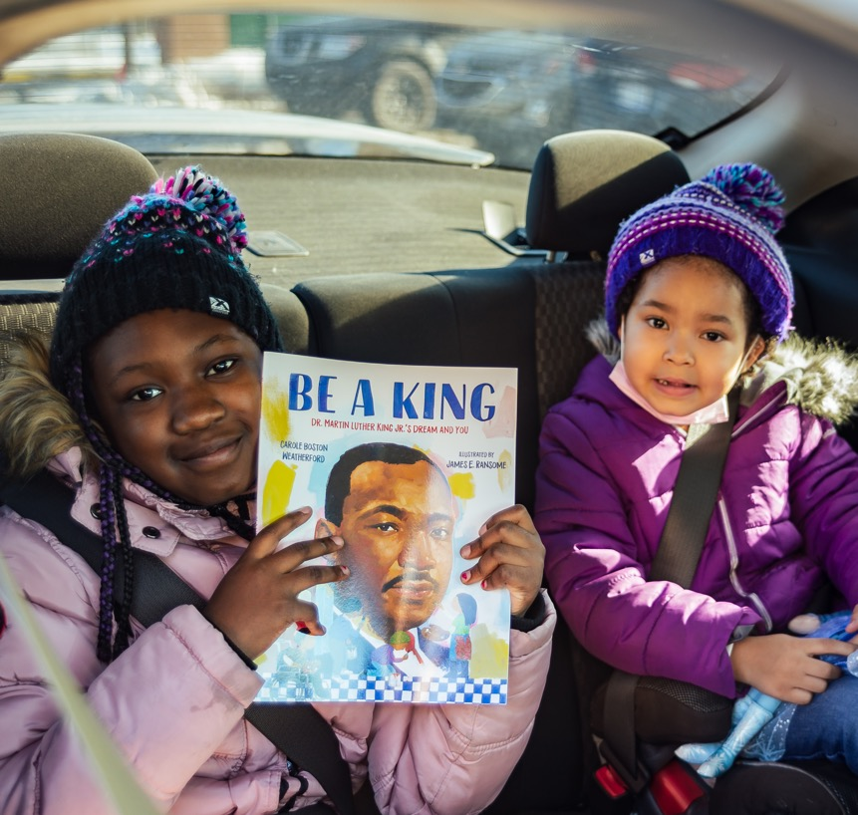
WHY DO WE
LIVE UNITED?
THE PROBLEM
ALICE
ALICE: TRI-COUNTY BREAKDOWN
ALICE: SURVIVAL BUDGET

Slide 9









THE PROBLEM
In Southeastern Michigan, nearly 40 percent of families struggle to afford basic needs like food, housing and health care.
CHILD CARE
TRANSPORTATION
TECHNOLOGY
Often, these families are just one missed paycheck or unexpected bill away from financial crisis.
FOOD
HOUSING
HEALTH CARE
Notes:
-Before the first case of COVID-19 ever hit Michigan, more than one in three households were already struggling to make ends meet. That’s over 1.5 million households, the vast majority of whom are working, whose incomes don’t cover the essential costs of a basic monthly budget.
-This is a systemic failure that impacts every single county, every community in the state, and addressing this unacceptable reality is the focus of our work.
-The ALICE report shows us the areas of greatest need in our community, as well as where systemic change is needed — like the high cost of quality health care, housing and child care, and lack of good-paying jobs.

Slide 10


ALICE:
ASSET LIMITED,
INCOME CONSTRAINED, EMPLOYED
United Way’s ALICE report tells us that hundreds of thousands of families in our region are not making
enough to afford a no-frills household budget.
  Released in 2021 with 2019 data
  Commissioned by United Way in 23 states
  Shows the true measure of "need" in our communities
  The problem is worse for Black and Hispanic families, as well as senior citizens
MICHIGAN
28%
Notes:
-ALICE stands for Asset Limited, Income Constrained, Employed. The ALICE report shows the true measure of how families in Michigan are faring by comparing income to the actual costs of living in our region and statewide.
-Our latest ALICE data comes from 2019 and was released in 2021, showing the state of our community's families before the pandemic hit.
-Though the percentage of ALICE households dropped from 2017 to 2019, this change is due in large part to methodology in how ALICE is calculated, rather than a true drop in need or increase in living wages

Slide 11
ALICE: TRI-COUNTY BREAKDOWN
This problem affects families in every city in our region.
  LIVONIA: 27% of households fall
  below the ALICE threshold (BAT)
  BIRMINGHAM: 19% of households BAT
  SHELBY TOWNSHIP: 32% of households BAT
MACOMB COUNTY
38.5%
OAKLAND COUNTY
32.7%
WAYNE COUNTY
56.7%
Notes:
Customize to fit your audience based on location.
The "ALICE threshold" is a combination of families living below the federal poverty level, as well as those whose income is above the poverty level, but still not enough to afford basic needs like food, housing and health care.
While only 13% of households in Michigan are reported to live at or below the poverty level, an additional 25% of households have incomes below the ALICE survival budget.

Slide 12








ALICE: SURVIVAL BUDGET
2 ADULTS, 2 CHILDREN
TAXES
$861
United Way’s ALICE report redefines the way that we measure economic hardship.
The ALICE budget calculation:
  Identifies the true cost of living according to actual expenses.
  Recognizes that cost of living varies by region and adjusts accordingly.
  Is based on the cost of “survival” and does not include savings.
MISCELLANEOUS
$596
HEALTH CARE
$569
TECHNOLOGY
$75
TRANSPORTATION
$929
FOOD
$811
CHILD CARE
$1,526
HOUSING
$1,193
ANNUAL TOTAL
$78,720
MONTHLY TOTAL
$6,560
Notes:
This is a breakdown of a two-parent family with two children. Additional budget breakdowns for a single adult and single senior citizen.
By comparison, the monthly total for the federal poverty level is only $2,092 for a family of four.

Slide 13
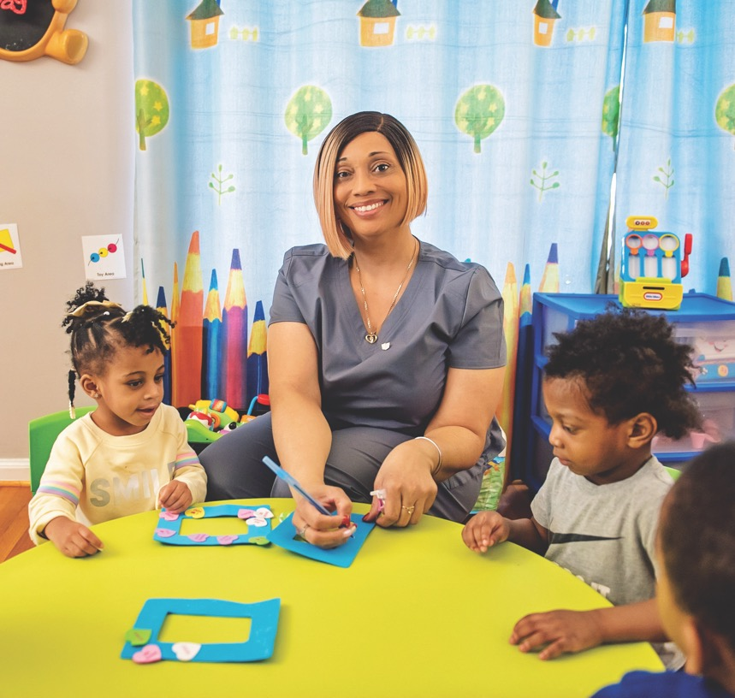
WHAT
WE DO
EQUITABLE COMMUNITIES OF STABLE HOUSEHOLDS AND THRIVING CHILDREN
AREAS OF FOCUS: 2021-22
HOW WE DO IT

Slide 14

At United Way,
we mobilize a network of hundreds of PARTNERS
and thousands of DONORS, ADVOCATES and VOLUNTEERS
to build equitable communities of stable households and thriving children.

Slide 15



EQUITABLE COMMUNITIES OF
STABLE HOUSEHOLDS AND THRIVING CHILDREN
EVERY PERSON has equal access to the resources and supports they need to succeed in life — regardless of who they are or where they live.
ALL FAMILIES should be able to meet their basic needs like food, housing and health care — the foundations of a stable household.
EVERY CHILD deserves a nurturing environment and a high-quality
education that prepares them
for success.
Notes:
What does that mean?
2-1-1 helpline: We provide hundreds of people daily with personalized connections to trusted community resources and programs.
Basic needs funding: Annually, we provide grant funding, support and technical assistance to dozens of partners like food pantries and homeless shelters.
Tax assistance: We work with a coalition of community, foundation and government partners to expand access to tax assistance and increase awareness of tax benefits for families.
Centers for Working Families: We support community hubs where workers can go for job training, financial support and more.
Crisis relief: We act quickly to support increases and shifts in need in times of crisis, like the COVID-19 pandemic and flooding.

Slide 16











AREAS OF FOCUS 2021-22
2-1-1 HELPLINE
ADVOCACY
BASIC NEEDS
ECONOMIC MOBILITY AND FAMILY FINANCES
EDUCATION AND LITERACY
DIGITAL INCLUSION
DIVERSITY, EQUITY AND INCLUSION
Notes:
2-1-1 helpline: Fund the go-to resource for those in need, available 24/7/365.
Advocacy: Support our work advancing policies that create long-term, positive change.
Basic needs: Connect struggling households with essential resources like housing, food
and child care.
Economic mobility and family finances: Help families increase household incomes through training programs and tax assistance.
Education and literacy: Fund our initiatives to keep students on track to succeed in school and in life.
Digital inclusion: Create equitable access to technology that students, seniors and families need to learn, work and connect.
Diversity, Equity and Inclusion: Fund initiatives and partnerships that deconstruct systemic racism and
institutional bias.
Keeping our 2-1-1 phone lines open 24/7/365
Ensuring all families can meet their basic needs
Providing students with the support they need to learn
Fighting inequity in all its forms

Slide 17






HOW WE DO IT
We help families get out of crisis — and stay out.
We bring people together.
We tackle the root causes of our community’s problems.
If families can’t meet their basic needs now, they can’t prepare for the future. Through strategic investments and innovative partnerships with corporations and nonprofits, we work with limited resources to help as many families as possible.
We tackle the root causes of longstanding challenges that impact families in our community — like a lack of access to quality child care, education supports and job training. We work to strengthen institutions and make changes through policy and partnership.
For more than 100 years, we have worked collaboratively with nonprofit, for-profit and government agencies to accomplish what no entity can do alone.
Notes:
We do this by:
Rapidly coordinating efforts and distributing funds to areas of greatest need during a community crisis, including supporting traditional crisis response partners like American Red Cross, when needs are greater than they are able to support.
Investing in and supporting equitable, innovative and collaborative programs and initiatives that help solve our community’s biggest problems.
Advocating and activating for long-term change and equity through public policy and collaboration with hundreds of community, business and government partners.

Slide 18

OUR
IMPACT
OUR COVID-19 IMPACT
COVID-19 IMPACT STORIES
MACKENZIE SCOTT GRANT
CRISIS AND RECOVERY FUND

Slide 19
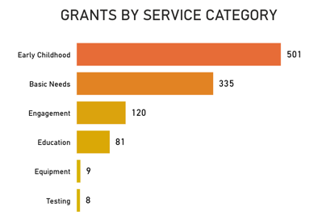
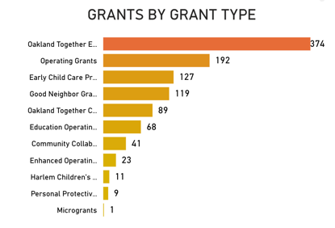
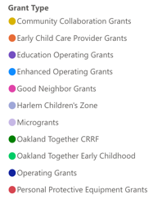
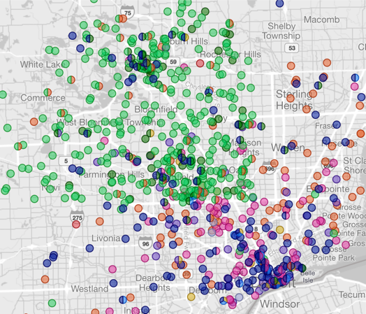

OUR COVID-19 IMPACT
$36 million distributed across our community
1,054 grants to community partners, schools, child-care facilities and more
More than 3 million people helped
15 million meals served
Strategic investments in digital equity, COVID-19 testing and vaccinations, and supporting communities of color
$37.74 MILLION
$35.97 MILLION
1,054
FUNDS RAISED
FUNDS AWARDED
GRANTS AWARDED
Notes:
-See the full details of our impact at www.UnitedWaySEM.org/COVIDImpact (including video and dashboards)

Slide 20



COVID-19 IMPACT:
STORIES
A woman called 2-1-1 because she needed help finding a food pantry. We were able to say not only can we connect you with a food bank, but we can get you there, too.”
– JOZETTE GAITERS,
2-1-1 CALL CENTER MANAGER (2020),
UNITED WAY FOR SOUTHEASTERN MICHIGAN
Notes:
Story link: https://unitedwaysem.org/blog/united-ways-2-1-1-helpline-serves-as-crucial-covid-19-service/

Slide 21
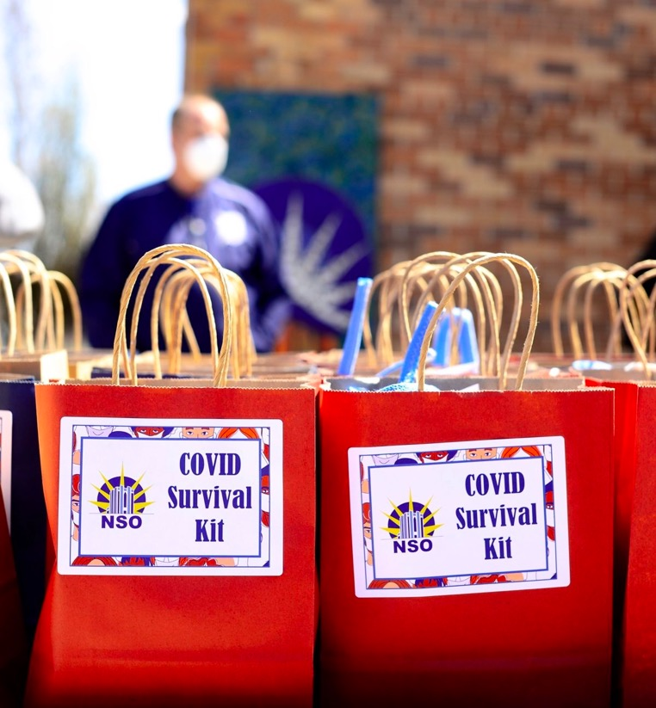

COVID-19 IMPACT:
STORIES
What we’re offering is a safe place for people to recover, prevent rehospitalization and make more efficient use of available hospital beds. We couldn’t have done that without United Way.”
– LINDA LITTLE,
PRESIDENT AND CEO,
NEIGHBORHOOD SERVICE ORGANIZATION
Notes:
Story link: https://unitedwaysem.org/blog/united-way-covid-19-fund-grants-help-detroiters-experiencing-homelessness-stay-safe-and-healthy/

Slide 22
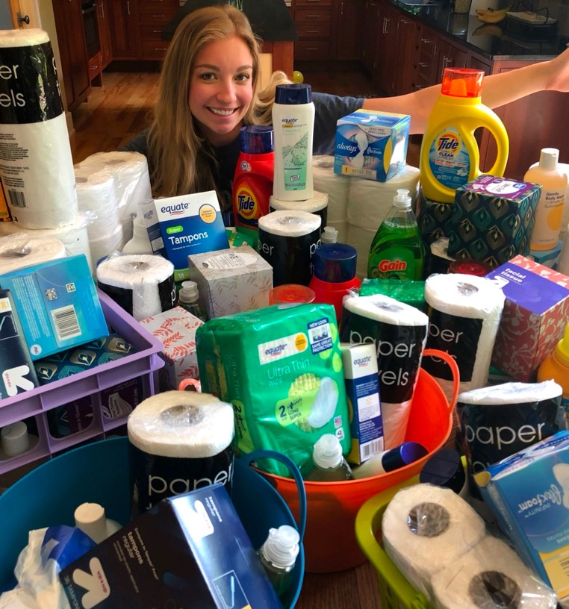


COVID-19 IMPACT:
STORIES
With the pandemic, we needed to ensure volunteers were staying safe, so this was a perfect time for us to roll out a DIY option for our volunteer kits. There’s a real need in the community and the kits help to ensure those needs don’t go unmet.”
– STEPHANIE RALLS,
DEI & ENGAGEMENT MANAGER,
UNITED WAY FOR SOUTHEASTERN MICHIGAN
Notes:
Story link: https://unitedwaysem.org/blog/diy-kit-projects-offer-safe-way-to-make-an-impact-through-volunteerism/

Slide 23

WE ROSE TO THE CHALLENGE, BUT WE STILL HAVE MORE WORK TO DO

Slide 24






MACKENZIE SCOTT GRANT
OUR VISION AND GOALS
To build out an effective, achievable and sustainable strategy for this grant that maximizes our immediate and long-term community impact, United Way will focus on two key objectives within the parameters set by Scott and her team.
1. DRIVE SYSTEMIC CHANGE WITHIN THE ALICE REPORT FRAMEWORK WITH AN EMPHASIS ON:
Building sustainable community-wide programs.
Investing in diversity, equity and inclusion.
2. INVEST IN INTERNAL CAPABILITIES AND GROWTH:
Talent development
Technology innovation
Emergency response

Slide 25
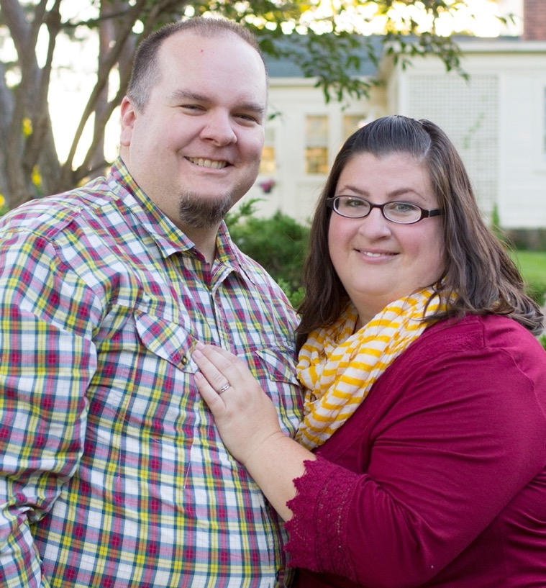

CRISIS AND RECOVERY FUND
Launched in summer 2021
Funds distributed to six partner agencies to help families impacted by regional flooding
$650,000+ raised so far
2-1-1 served as regional support hub for help and volunteerism
We felt we had somebody in our
corner to help us out. And they weren’t judging us at all.”
– JULIE SEXTON,
MOTHER OF SEVEN, WHO RECEIVED HELP THROUGH
UNITED WAY’S CRISIS FUND
Notes:
Launching this fund allowed us to quickly mobilize resources during a community crisis without impacting existing programs.

Slide 26
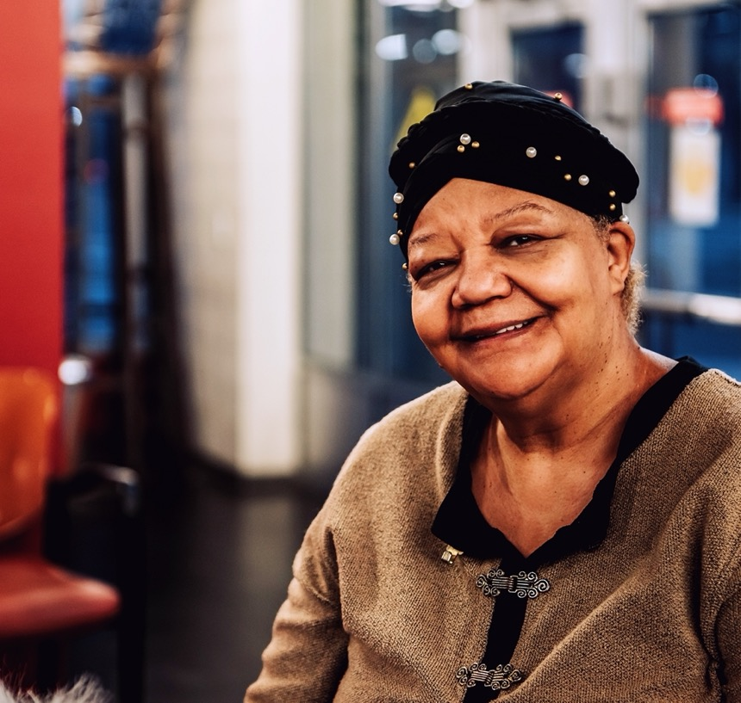
WHERE WE
ARE HEADED
COMMUNITY FUND
2-1-1 HELPLINE
ADVOCACY
BASIC NEEDS
ECONOMIC MOBILITY
AND FAMILY FINANCES
EARLY CHILDHOOD
EDUCATION AND LITERACY
DIGITAL INCLUSION
DIVERSITY, EQUITY
AND INCLUSION

Slide 27

COMMUNITY INVESTMENT FUND
Maximize your contribution to focus on the greatest community need.
Allows United Way to shift gears in times of unexpected crisis to meet growing and changing needs.
Using input and data from 2-1-1 and our partners, we can anticipate changes in need.
Helps support spikes in 2-1-1 helpline requests
Notes:
Highlight the impacts of giving unrestricted gifts and how it allows us to address areas of greatest need as focuses shift.
focus on "tell United Way to put your money where it is most needed for the greatest impact" and highlight our unique ability to respond to spikes in need.

Slide 28


2-1-1 HELPLINE
Fund the go-to resource for those in need, available 24/7/365.
LAPEER
  A one-stop-shop connecting callers with more than 30,000 resources in our region
  Call center representatives provide
  one-on-one help to people in need
  Available via phone, text, chat or email
  Serves the counties of Wayne,
  Oakland, Macomb, Lapeer, Monroe
  and Washtenaw.
OAKLAND
MACOMB
POWERED BY
WASHTENAW
WAYNE
MONROE
Notes:
Impact stats:
106,152 connections made in 2019-20.
Top requests: food, utility assistance, rent payment assistance, COVID-19 testing.

Slide 29
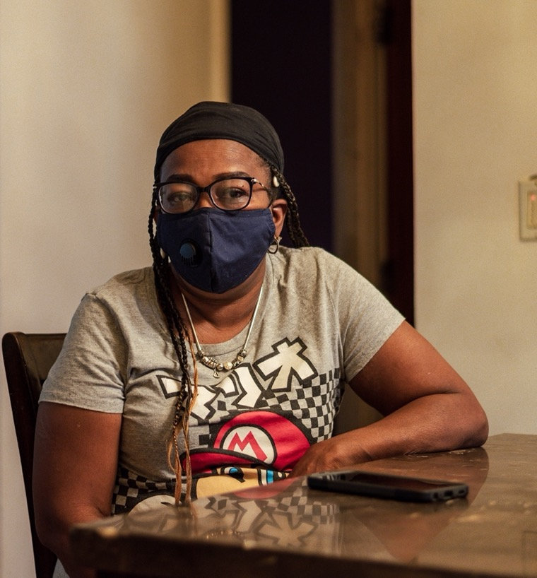

2-1-1 HELPLINE:
OUR IMPACT
106,152 connections made in 2019-20.
Top requests: food, utility assistance, rent payment assistance, COVID-19 testing.
It’s crazy how much money you have to spend to get to a job. Transportation can end up being a big part of your check. But if you don’t pay to get to work, you don’t get paid. It’s like a cycle where you never get ahead.”
– CAROLYN BIRD,
DETROIT RESIDENT
CALLED 2-1-1 FOR HELP
Notes:
Full story: https://unitedwaysem.org/blog/united-ways-2-1-1-helpline-serves-as-crucial-covid-19-service/

Slide 30







ADVOCACY
Support our work advancing policies that create long-term, positive change.
WE WILL ADVANCE
OUR POLICY GOALS BY:
Building relationships
Tracking legislation
Educating legislators
Community advocacy
2021-22 FOCUSES:
ALICE BUDGET
INCOME AND
ECONOMIC MOBILITY
EQUITY, INCLUSION AND
CIVIC ENGAGEMENT
Notes:
Building relationships: Sharing information and data with local, state and federal elected leaders
Tracking legislation: Researching, analyzing and tracking proposed legislation, executive orders and administrative rules to determine the potential impact on
those we serve.
Educating legislators: Urging legislators to vote in a manner that protects the best interests of all people and the well-being of our community.
Community advocacy: Raising community awareness of proposed policy changes and coordinating grassroots efforts to speak out in support or opposition.
IMPACT
COVID-19 RELIEF
500+ United Way advocates pushed for COVID-19 relief in 2020.
1,500+ phone calls, emails and tweets sent made to Congress.
EARNED INCOME TAX CREDIT
70+ United Way advocates pushed for increasing the EITC in 2020.
Nearly 400 emails, tweets and phone calls to state and federal legislators.

Slide 31
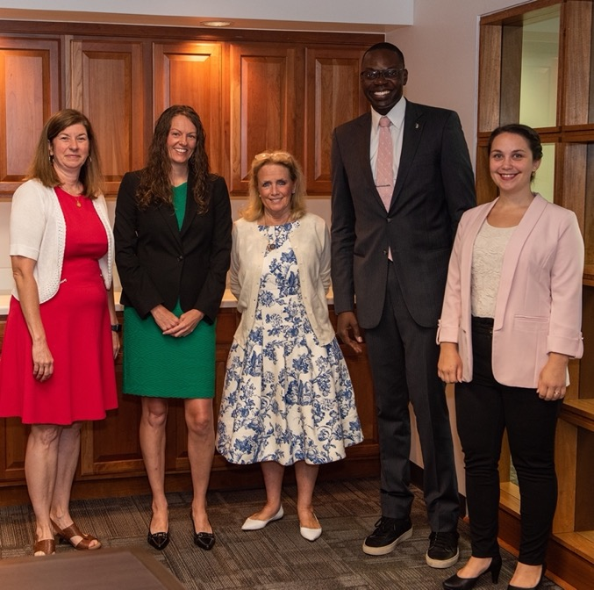
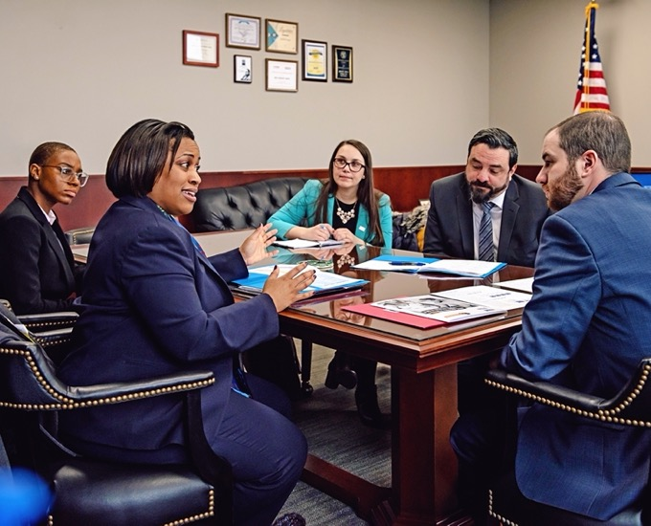


ADVOCACY: OUR IMPACT
COVID-19 RELIEF
500+ United Way advocates pushed for COVID-19 relief in 2020.
1,500+ phone calls, emails and tweets sent made to Congress.
EARNED INCOME TAX CREDIT
70+ United Way advocates pushed for increasing the EITC in 2020.
Nearly 400 emails, tweets and phone calls to state and federal legislators.

Slide 32
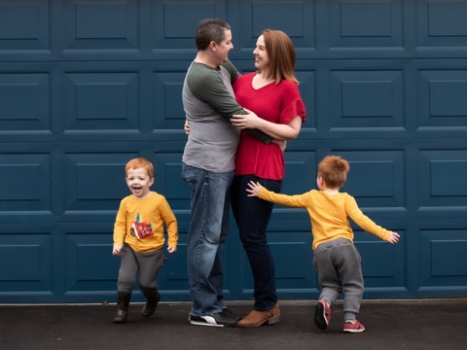
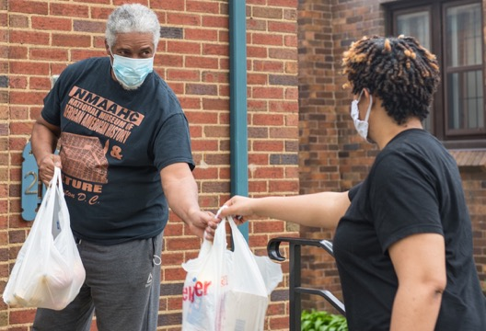
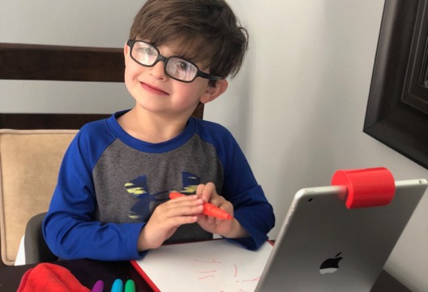
BASIC NEEDS
Connect struggling households with essential resources like housing, food
and child-care.
2021-22 FOCUSES:
HOUSING AND
UTILITY ASSISTANCE
FOOD
HEALTH CARE
CHILD CARE
Notes:
Impact stats:
-1.9 million people received food access through COVID-19 funded partners
-6,308 individuals connected with utility assistance
-More than 35,000 people provided with homelessness and housing services during COVID-19 crisis.

Slide 33
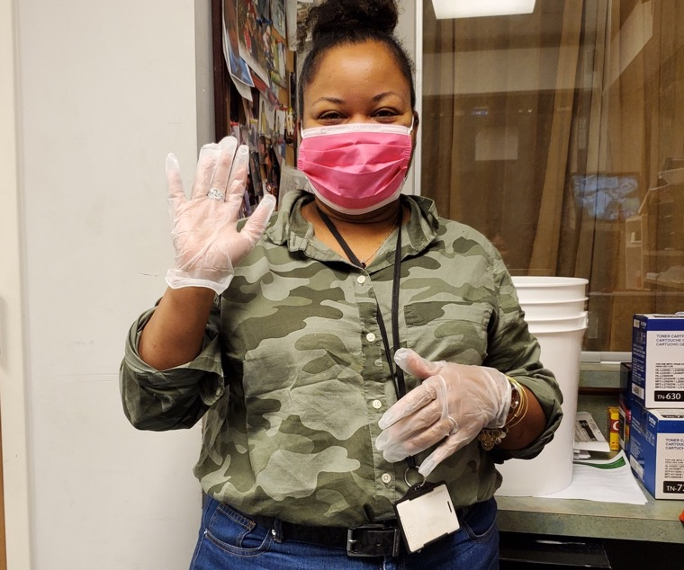


BASIC NEEDS: OUR IMPACT
1.9 million people received food access through COVID-19 funded partners
6,308 individuals connected with utility assistance
More than 35,000 people provided with homelessness and housing services during COVID-19 crisis.
There are still girls that have nowhere to go during this time. If we’re closed, they’ll be in the street or staying with someone that is not a healthy arrangement for them. We’re staying open, and to do that, we’re really stretching our resources.”
– CELIA THOMAS,
CHIEF OPERATING OFFICER,
ALTERNATIVES FOR GIRLS
Notes:
Full story: https://unitedwaysem.org/blog/covid-19-response-fund-partner-profile-alternatives-for-girls/

Slide 34
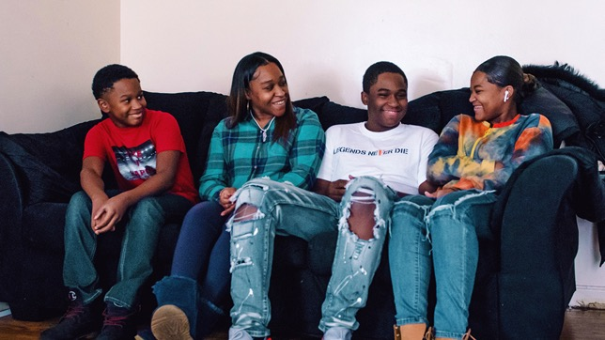


ECONOMIC MOBILITY AND FAMILY FINANCES
Help families increase household incomes through training programs and
tax assistance.
2021-22 FOCUSES:
CENTERS FOR WORKING FAMILIES
TAX ASSISTANCE
Notes:
Impact stats:
$310 million claimed through the Earned Income Tax Credit (EITC) in 2020.
4,686 people connected with financial coaching services.
919 individuals enrolled in training or education.
1,100 workers placed in a job.

Slide 35
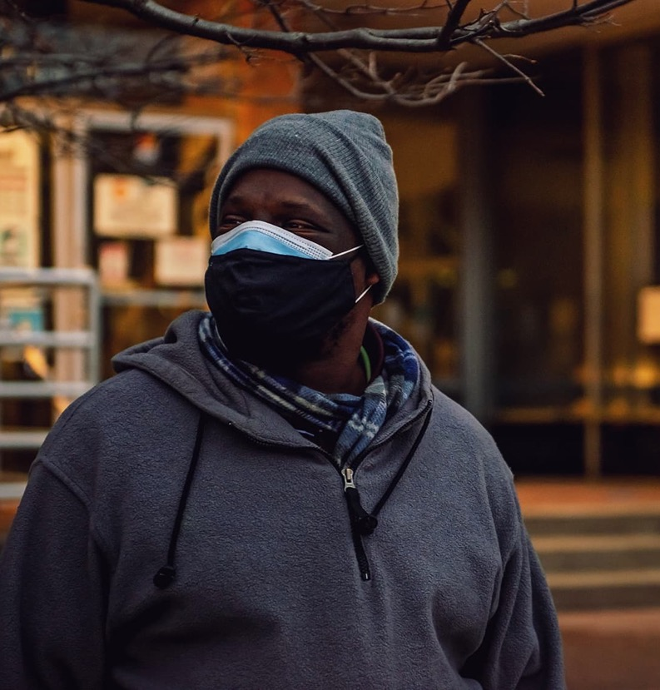

ECONOMIC MOBILITY AND FAMILY FINANCES:
OUR IMPACT
$310 million claimed through the Earned Income Tax Credit (EITC) in 2020.
4,686 people connected with financial coaching services.
919 individuals enrolled in training or education.
1,100 workers placed in a job.
It’s a haven of possibility. It helps get you to where you want to be.”
– DARRIN OGBURN,
WHO WAS HOMELESS FOR 17 YEARS
BEFORE HE FOUND HELP THROUGH A CWF
Notes:
Full story: https://unitedwaysem.org/out-of-crisis-united-against-homelessness/

Slide 36
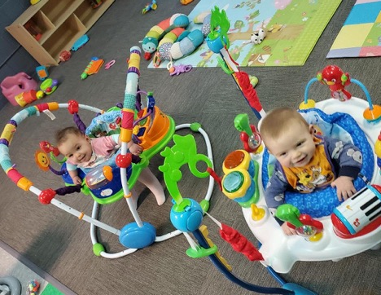
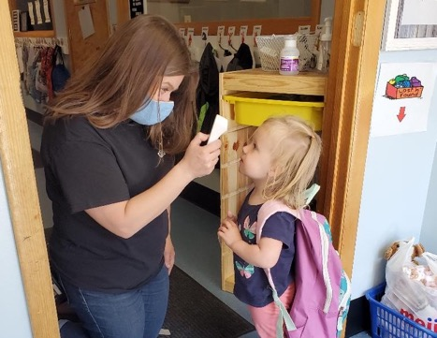

EARLY CHILDHOOD
Support our efforts to ensure every family can access quality, affordable child care.
2021-22 FOCUSES:
CONNECT4CARE KIDS
READY4K
SUPPORTS FOR CHILD CARE PROVIDERS AND CENTERS
Notes:
Connect4Care Kids launched in Detroit in 2020 and expanded to Wayne County in 2021. Goal: Expand to Oakland and Macomb counties by 2022.
Support programs for parents and child care providers:
Ready4K text message support
Training and support for child care providers and centers
Providing emergency support to care providers through grants and PPE distribution
Impact stats:
145 care providers have participated in our Child Development Associate program since its inception.
400 essential workers connected with child care during 2020.
More than 300,000 pieces of PPE distributed to child care providers.

Slide 37
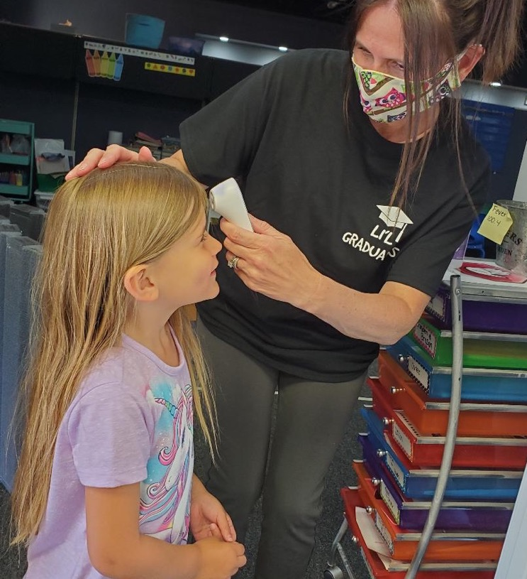

EARLY CHILDHOOD:
OUR IMPACT
145 care providers have participated in our Child Development Associate program since its inception.
400 essential workers connected with child care during 2020.
More than 300,000 pieces of PPE distributed to child care providers.
When COVID-19 hit, we were committed to being there for the families who needed us. We’re glad United Way was there for us in return.”
– JAMIE MIDDAUGH,
DIRECTOR,
LI’L GRADUATES CHILD DEVELOPMENT CENTER
Notes:
Full story: https://unitedwaysem.org/blog/covid-19-grants-help-child-care-providers-produce-lil-graduates/

Slide 38
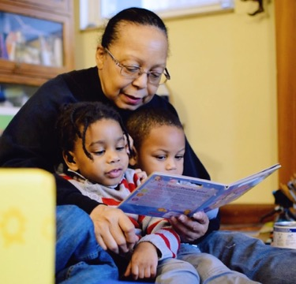

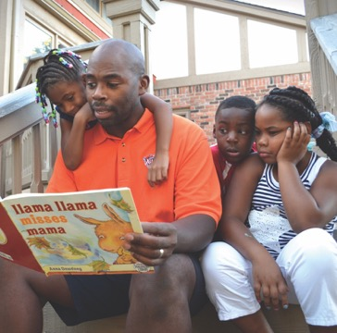

EDUCATION AND LITERACY
Fund our initiatives to keep students on track to succeed in school and in life.
2021-22 FOCUSES:
LITERACY
COMMUNITY SCHOOLS
DIGITAL INCLUSION
Notes:
Impact stats
8,000+ K-12 students across Wayne, Oakland and Macomb counties provided with more than 33,000 free books.
6,500 parents and caregivers receiving literacy and growth text tips and support through READY4K.

Slide 39
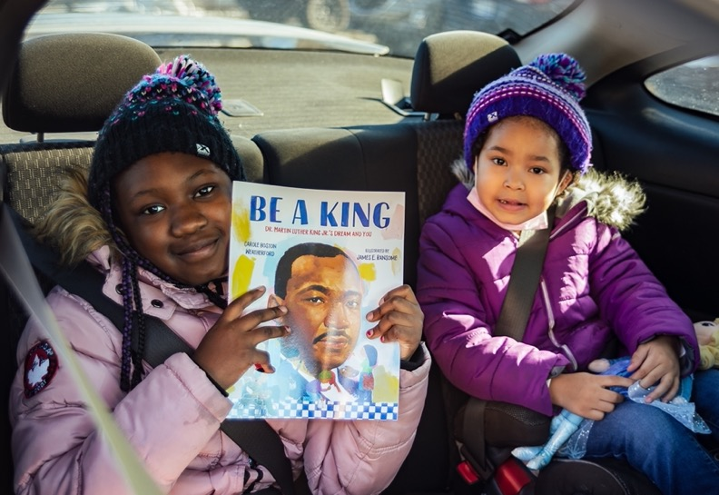
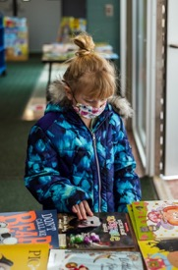
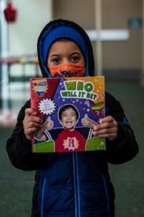
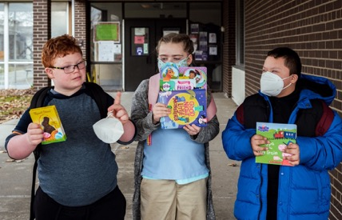
EDUCATION AND LITERACY:
OUR IMPACT
8,000+ K-12 students across Wayne, Oakland and Macomb counties provided with more than 33,000 free books.
6,500 parents and caregivers receiving literacy and growth text tips and support through READY4K.

Slide 40
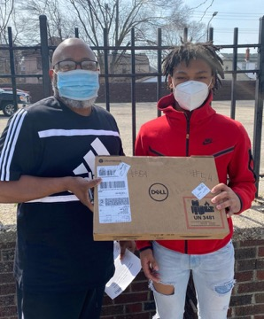
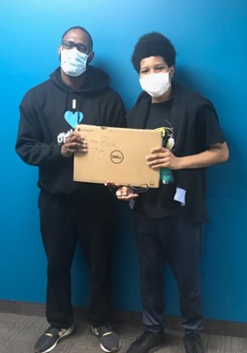
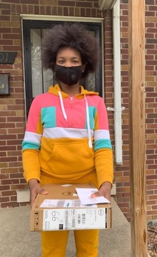
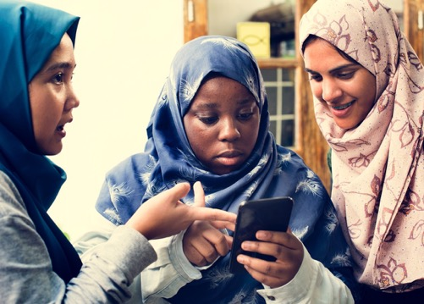
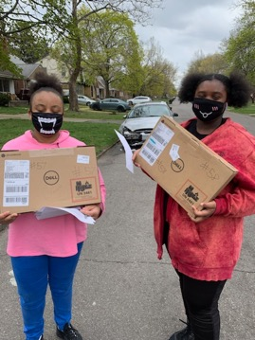
DIGITAL INCLUSION
Create equitable access to technology that students, seniors and families need to learn, work and connect.
2021-22 FOCUSES:
CONNECTING STUDENTS WITH TECHNOLOGY
CONNECT 313
Notes:
Impact stats:
More than 8,000 students provided with technology devices for school.
4,000 seniors connected with devices, technology and training through Focus: HOPE

Slide 41
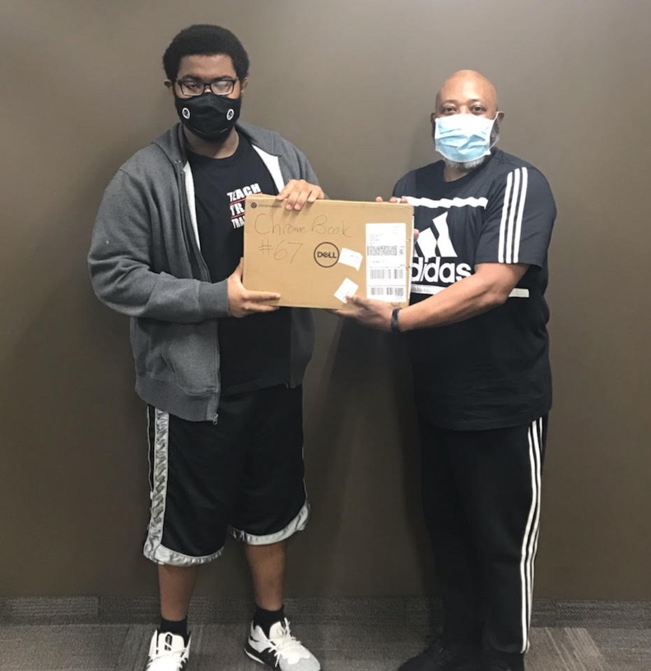

DIGITAL INCLUSION:
OUR IMPACT
More than 8,000 students provided with technology devices for school.
4,000 seniors connected with devices, technology and training through Focus: HOPE
Connected devices are the pathway to an awful lot of places. Without access, students have a very limited view of the world. It’s the way to apply for jobs, to find resources or to look for a new home if a family gets evicted. It’s everything.”
– TERRENCE GEORGE,
SUPERINTENDENT,
COVENANT HOUSE SCHOOL IN DETROIT
Notes:
Full story: https://unitedwaysem.org/blog/digital-divide-students/

Slide 42



DIVERSITY, EQUITY AND INCLUSION
Fund initiatives and partnerships that deconstruct systemic racism and
institutional bias.
2021-22 FOCUSES:
RACIAL EQUITY FUND
21-DAY EQUITY CHALLENGE
Notes:
Impact stats:
In 2020, we began building an internal DEI department and volunteer staff committee to drive an equity focus in everything we do.
5,000+ people participated in our first-ever 21-Day Equity Challenge in May and June 2021.

Slide 43
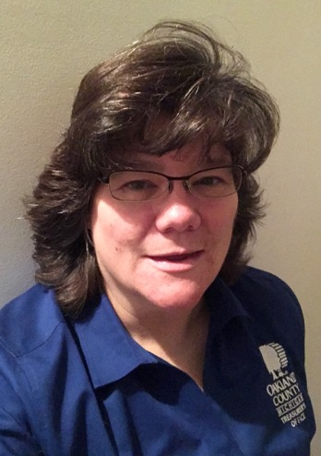
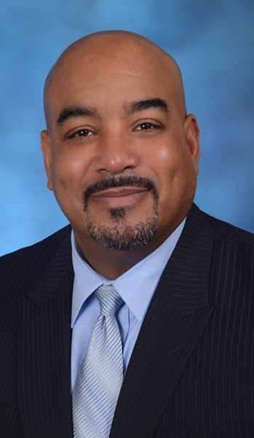


DIVERSITY, EQUITY AND INCLUSION: OUR IMPACT
In 2020, we began building an internal DEI department and volunteer staff committee to drive an equity focus in everything we do.
5,000+ people participated in our first-ever 21-Day Equity Challenge in May and June 2021.
Deaf people are so much more than their disability. And simply being able to hear does not make a person better than someone who is deaf.”
Uncomfortable conversations are necessary. I’m not going to do my son a disservice by not having them. Regardless of how unfair that may be when he’s just trying to be a kid, it’s real.”
– MARY GILLMAN,
21-DAY EQUITY CHALLENGE PARTICIPANT,
FARMINGTON
– DENNIS HAINES,
21-DAY EQUITY CHALLENGE PARTICIPANT,
SHELBY TOWNSHIP
Notes:
Mary Gillman testimonial: https://unitedwaysem.org/blog/equity-challenge-reflections-mary-gillman
Dennis Haines testimonial: https://unitedwaysem.org/blog/equity-challenge-reflections-dennis-haines/

Slide 44
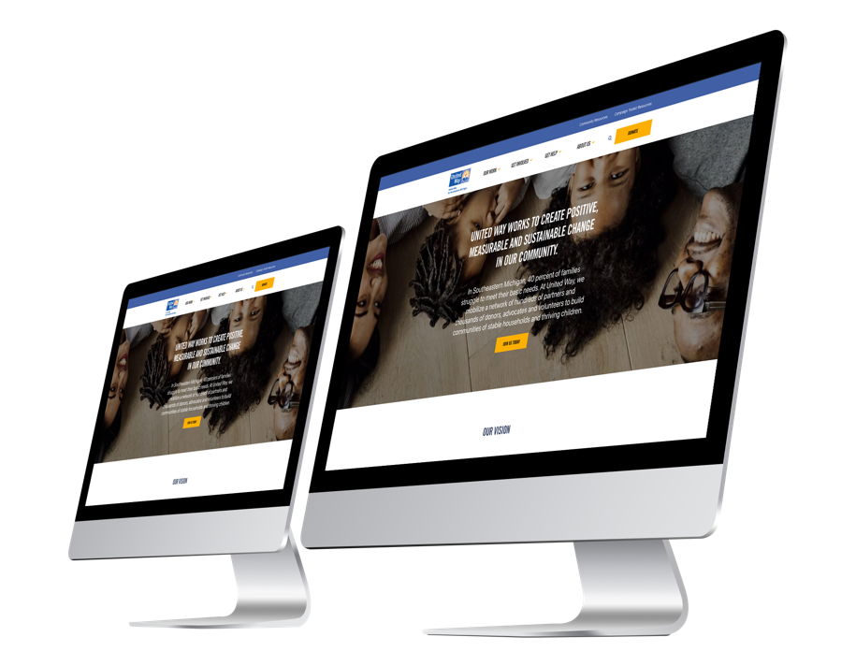
LEARN MORE AND SIGN UP
Read our blog: UnitedWaySEM.org/blog
Sign up for updates: UnitedWaySEM.org/subscribe
Follow us on social media:
  Facebook: @UnitedWaySEM
  Twitter: @UnitedWaySEM
  Instagram: @UnitedWaySEM
  LinkedIn: @UnitedWaySEM
  YouTube: UnitedWaySEMich

Slide 45
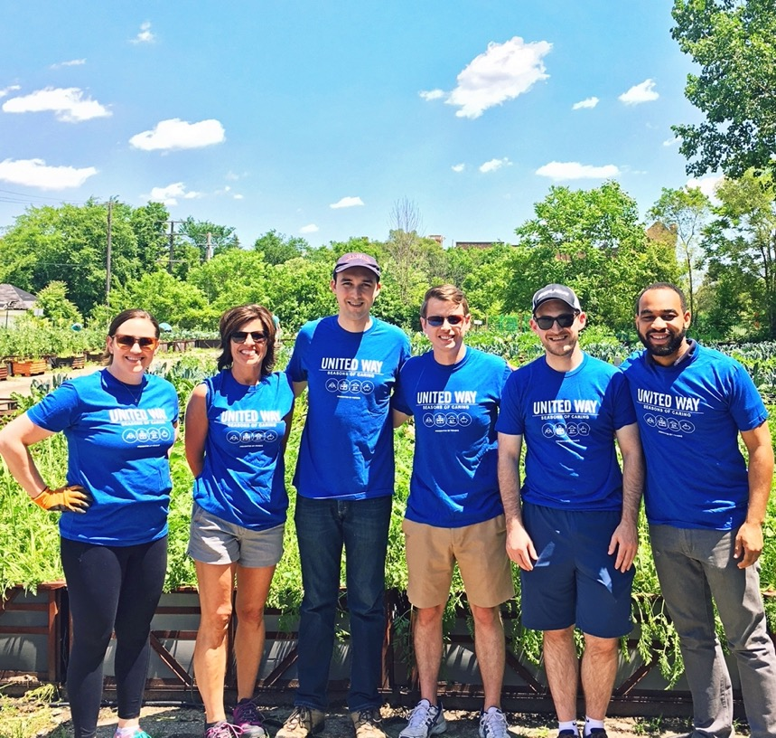
HOW TO
GET INVOLVED
GIVE
ADVOCATE
VOLUNTEER
(COMPANY NAME) AND UNITED WAY HISTORY
2021-22 CAMPAIGN DATES
2021-22 EMPLOYEE CAMPAIGN CHAIRPERSON
2021-22 CAMPAIGN GOALS
TECHNOLOGY SUPPORT AND DATA RESOURCES

Slide 46


GIVE. ADVOCATE. VOLUNTEER.
UnitedWaySEM.org/Get-Involved

Slide 47








GIVE
When you give to United Way, you help ensure that our community will not only recover from this crisis, but come out stronger and more resilient.
YOUR SUPPORT HELPS US:
  Keep our 2-1-1 helpline open 24/7/365
  Provide technology, mentoring and support to students
  Ensure that all families can meet their basic needs
  Fight inequity in all its forms
GIVE TODAY:
UnitedWaySEM.org/Give

Slide 48








ADVOCATE
When you advocate with United Way, you make a difference.
We rally our partners and supporters to advance the United Way mission by advocating for meaningful change at the local, state and national levels.
STAY UP TO DATE AND TAKE ACTION
through our advocacy alerts: UnitedWaySEM.org/AdvocacyAlerts

Slide 49











SEASONS OF CARING: VOLUNTEER
United Way works to build communities of stable households and thriving children, and volunteers are critical to this mission.
JOIN UNITED WAY AS A VOLUNTEER
There are always opportunities to give back:
  In person
  Virtually
  On your own
SIGN UP:
UnitedWaySEM.org/Volunteer

Slide 50
(COMPANY NAME) AND UNITED WAY HISTORY
This is the place to include information regarding your company’s involvement and history with United Way.
  Include narrative bullets
  History of the relationship
  Past giving history
  Campaign highlights

Slide 51
2021-22 CAMPAIGN DATES
This is a place to communicate information regarding events surrounding your company’s United Way campaign, including the start and end date.
  Campaign kickoff
  Virtual Cost of Living Simulation
  Campaign end

Slide 52
2021-22 EMPLOYEE CAMPAIGN CHAIRPERSON
FirstName LastName
TITLE,
DIVISION
FirstName.LastName@CompanyName.org
000-000-0000

Slide 53

2021-22 CAMPAIGN GOALS
Enter your campaign goal(s). Goal(s) could be based on % of participation, overall dollars raised, average gift, Leadership Giving, etc.
  2019 Participation: XX%
  2020 Participation goal: XX%
  2019 Average gift: $XXX
  2020 Average gift goal: $XXX
  Total Giving: $XXX
  Total Giving Goal: $XXX
  Total Volunteer Participation: XX%
  Total Volunteer Participation Goal: XX%

Slide 54

DATA RESOURCES THAT SUPPORT ORGANIZATIONAL AND COMMUNITY LEARNING
The Research, Data and Analytics Team supports:
  Construction of tailored and compelling analytic and visualization products that support storytelling and translate data into actionable information.
  Development of a data-driven culture that uses data to assess strategies, measure impact, communicate transparently about our work, and engage in continuous improvement to meet evolving community needs.
  Organization-wide learning and data-informed decision making through analysis, interpretation and visualization of data for business units across the organization.

Slide 55
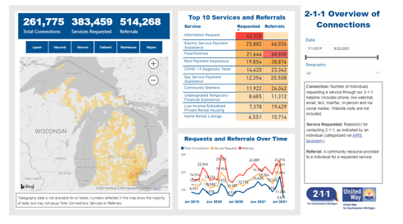
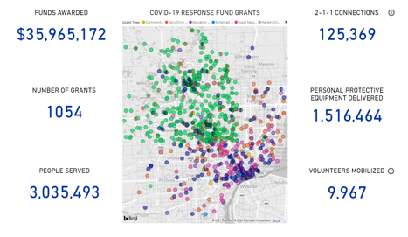
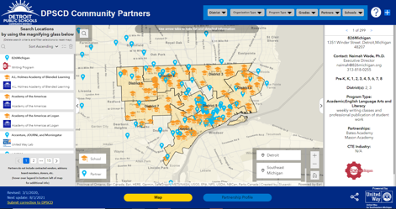
EXAMPLES OF DATA VISUALIZATION COMMUNITY RESOURCES
2-1-1 DASHBOARDS
Series of interactive dashboards that explore how call center volume change overtime and the top services and referrals across our region.
COVID-19 IMPACT
Learn how — with our supporters, partners and volunteers — we’re helping our region respond to and recover from the impacts of COVID-19.
DPSCD COMMUNITY PARTNERS
Interactive map of partnerships and community programs across Detroit Public Schools Community District.

Slide 56
IGNITE:
GIVE AT WORK CAMPAIGN TOOL
Ignite is a convenient tool that can be used to run electronic corporate workplace giving campaigns. The tool allows for increased employee campaign engagement, streamlined gift collection, reporting, and more.
BENEFITS
  Set up and maintenance provided by United Way for Southeastern Michigan
  Administrative access for campaign coordinators with real time report access
    Ability to create Dashboards to view data
  Support from United Way for Southeastern Michigan
    Email support inbox
    User guides and training

Slide 57
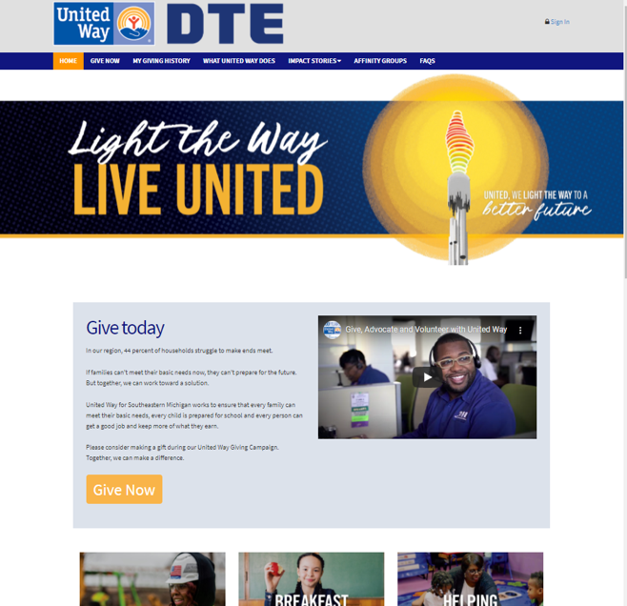
IGNITE:
GIVE AT WORK CAMPAIGN TOOL
FEATURES
  Custom link and logos
  Secure log in options
  Custom messaging and automatic emails
  Streamlined user experience to make or modify pledges during the campaign period
  Variety of pledge methods available (Payroll, Credit Card, Check, Stock)
  Ability to view campaign giving history year over year
Pictured: sample view of a campaign homepage

Slide 58




