Slide 1

2018-2019
UNITED WAY
CAMPAIGN
UNITED WAY FOR SOUTHEASTERN MICHIGAN

Slide 2
WE LIVE UNITED
FOR UNIVERSAL SUCCESS AND PROSPERITY
IN SOUTHEASTERN MICHIGAN
UNITED WAY FOR SOUTHEASTERN MICHIGAN

Slide 3



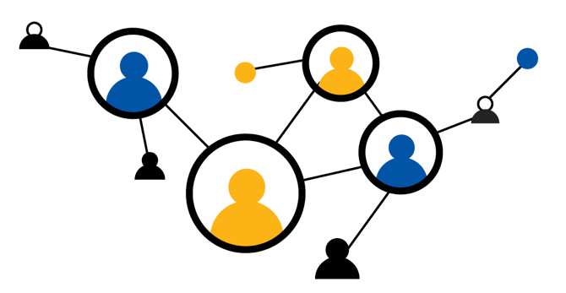

WHAT WE DO
WE IDENTIFY
BROKEN SYSTEMS
WE DEVELOP
SOLUTIONS
WE BRING
PEOPLE TOGETHER
WE CHANGE LIVES
FOR THE BETTER
We identify the root causes of longstanding challenges in education, employment and health systems, and use innovation to maximize resources and strengthen institutions to better serve our community.
We research the institutions providing public services and work to make them better.
We work to make sure people have their basic needs met when an emergency strikes, while also creating access to opportunities for a better life.
For more than 100 years, we have worked collectively with nonprofit, for-profit and government agencies to accomplish what no entity can do alone.
You can join our mission by giving, advocating and volunteering.
When we unite behind a common cause, with a common vision, lives are improved and our community is stronger.
UNITED WAY FOR SOUTHEASTERN MICHIGAN

Slide 4
WHY LIVE UNITED
Our community impact work is rooted in helping individuals access opportunities so they can provide for themselves and their families.
Our focus areas — Education, Economic Prosperity and Health — are interconnected, helping people in all stages of life achieve a better future.
UNITED WAY FOR SOUTHEASTERN MICHIGAN

Slide 5
OUR FOCUS AREAS
EDUCATION
ECONOMIC PROSPERITY
HEALTH
UNITED WAY FOR SOUTHEASTERN MICHIGAN

Slide 6
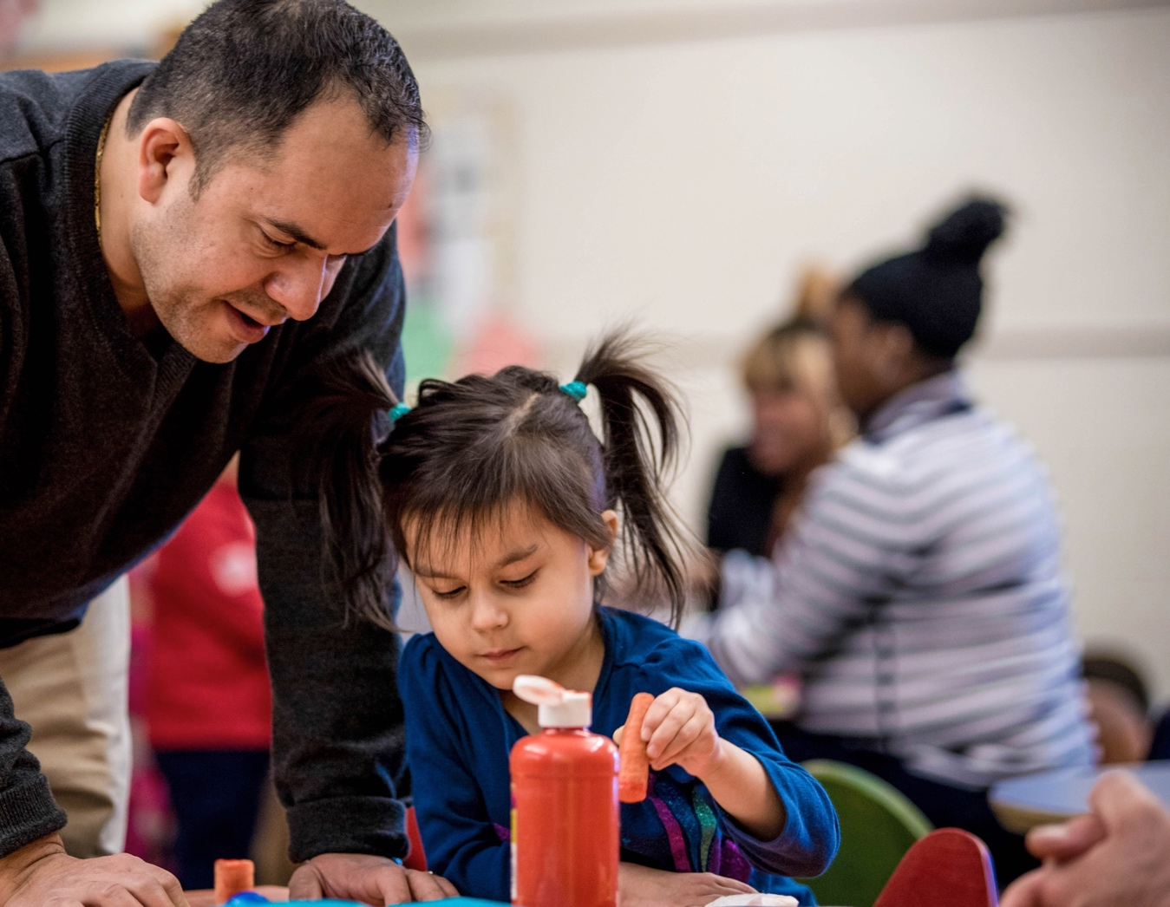
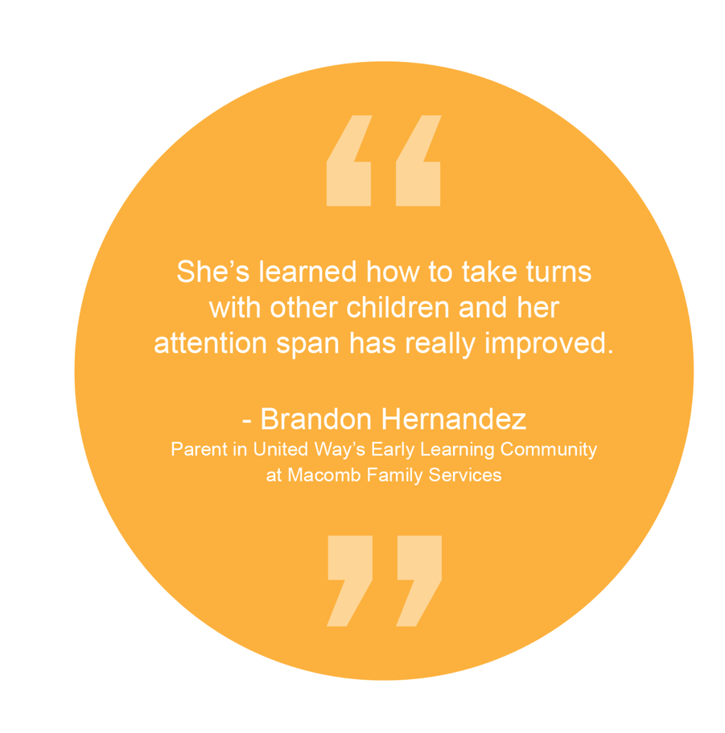
EDUCATION
Only 60 percent of children start kindergarten ready to succeed. In Detroit, 61 percent of students enroll in college within a year of graduating high school, but only 16 percent of them earn a degree within six years.
Our programs help new parents find care-giving resources, support childhood literacy and prepare high school students for college and a career.
UNITED WAY FOR SOUTHEASTERN MICHIGAN

Slide 7
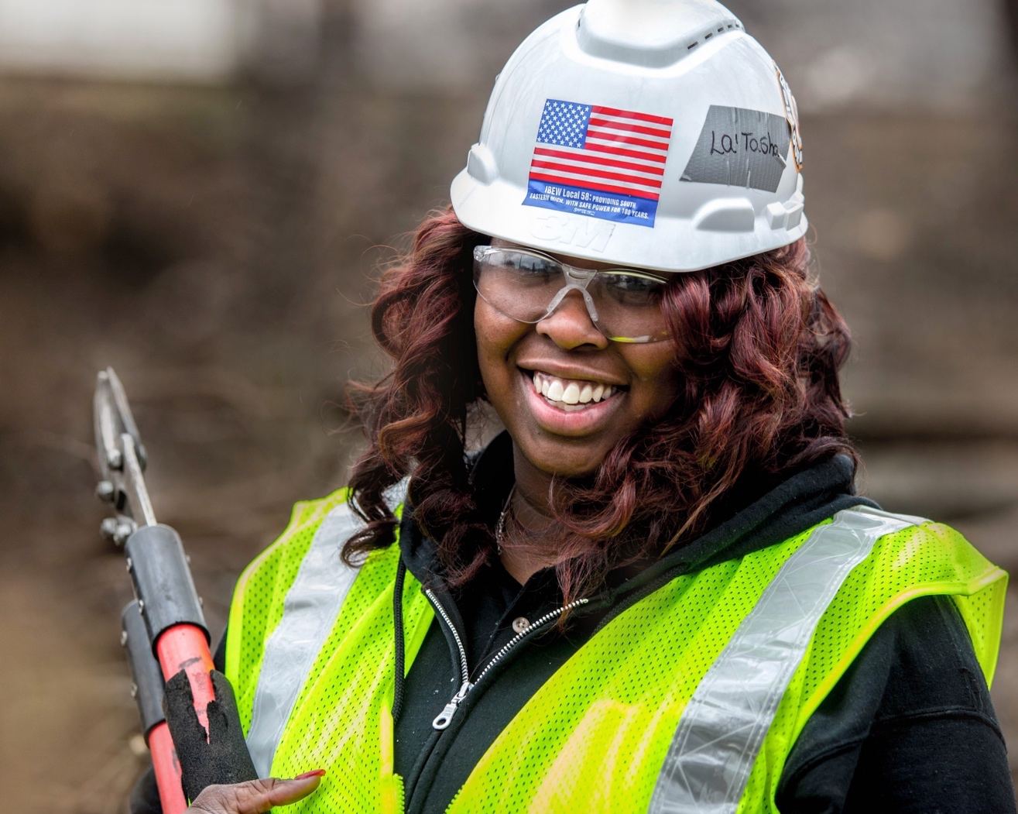
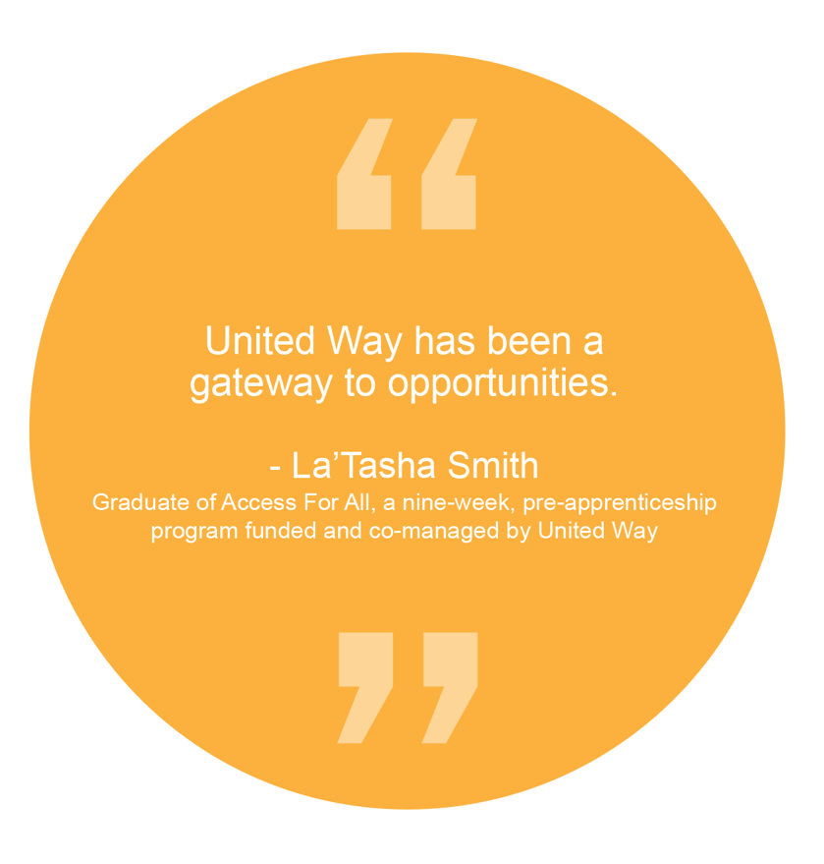
ECONOMIC PROSPERITY
Detroit's unemployment rate is 9.6 percent - significantly higher than the regional and national rates.
Through programs like Access for All, we help people train for and access good jobs. We also connect people with financial coaching and tax preparation so they can learn how to budget for the future and better provide for their families.
UNITED WAY FOR SOUTHEASTERN MICHIGAN

Slide 8
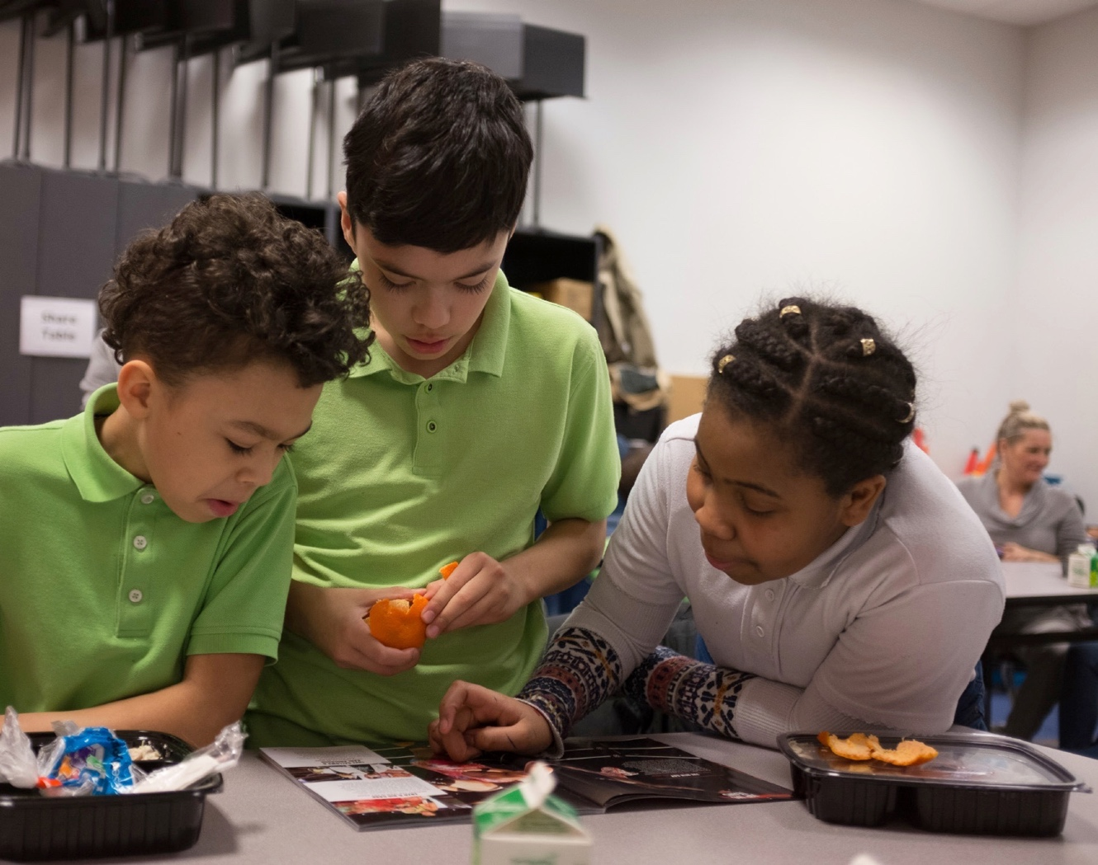
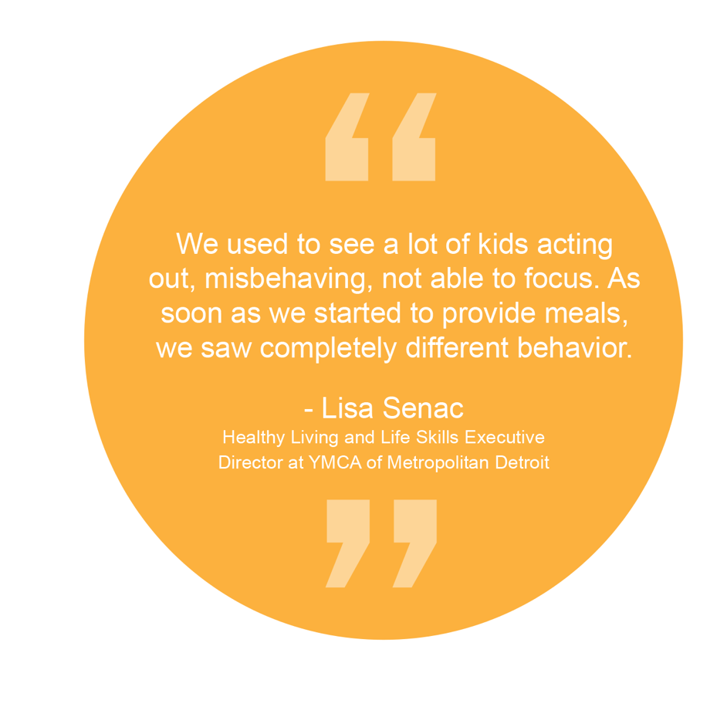
HEALTH
Forty percent of households struggle to afford basic necessities like housing, food and health care.
We build strong communities by promoting healthy eating and physical activity, expanding access to quality health care and investing in basic needs programs.
UNITED WAY FOR SOUTHEASTERN MICHIGAN

Slide 9
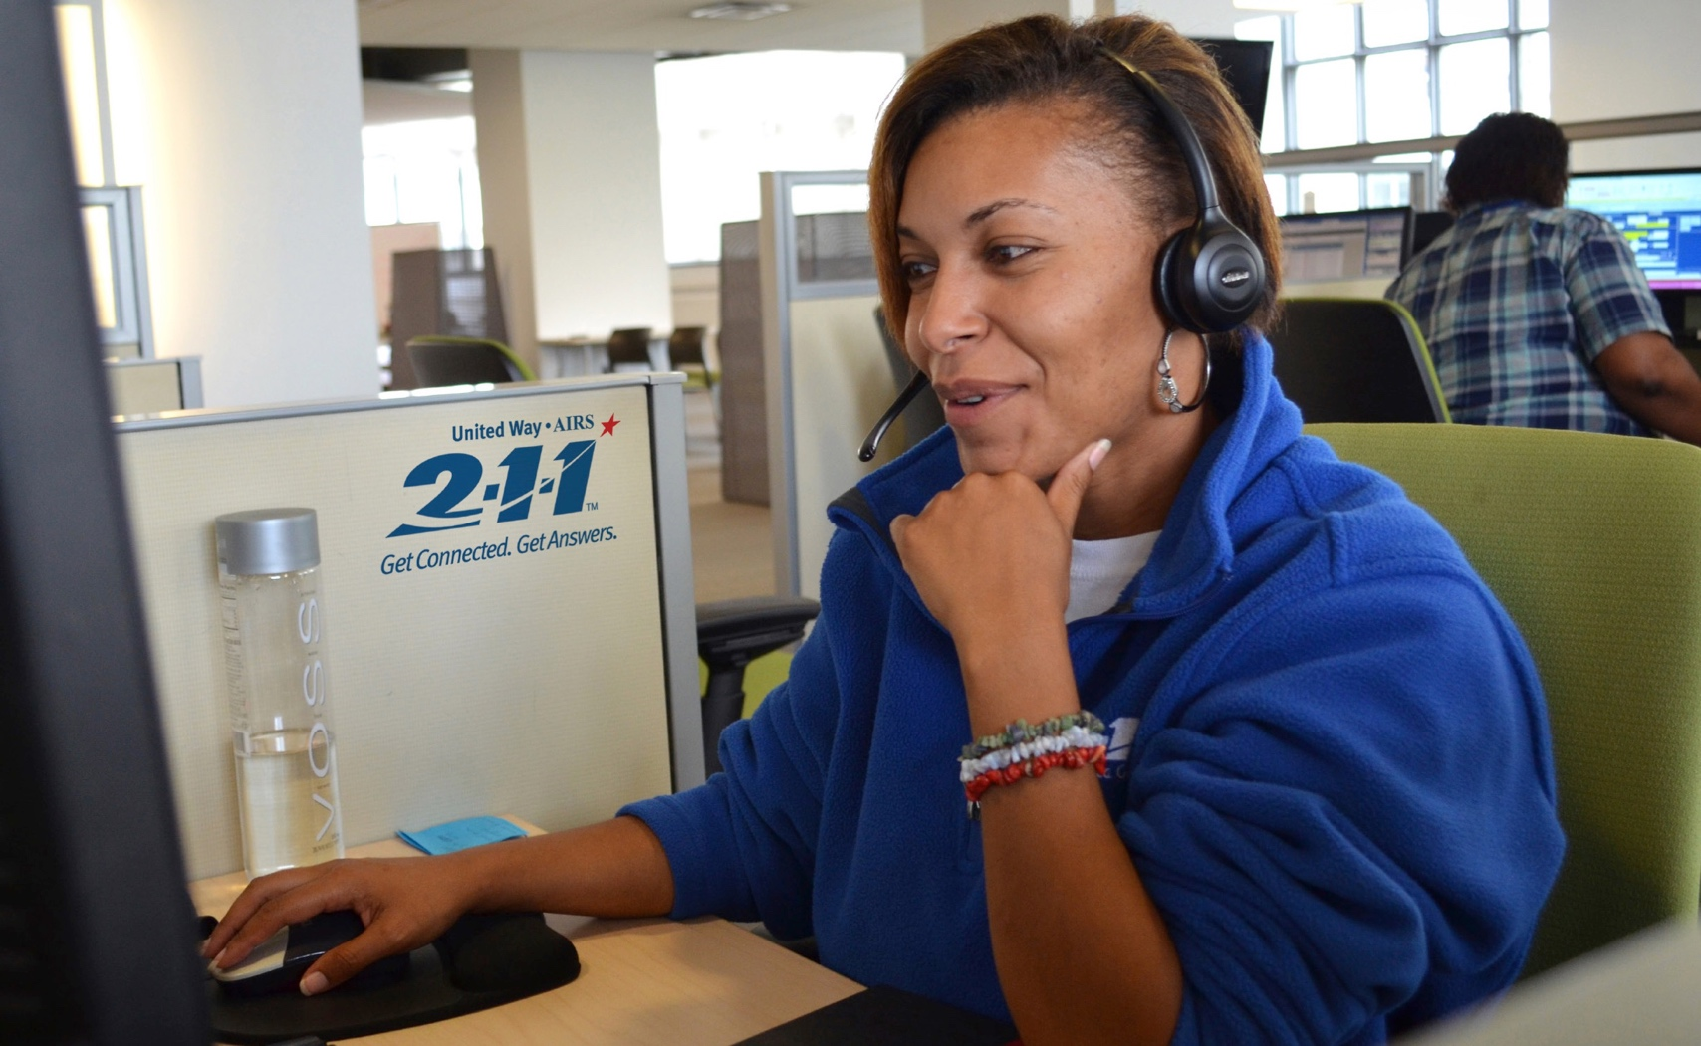
2-1-1 CALL CENTER
WE OFFER HELP AND HOPE
Dial 2-1-1. Our team connected more than 234,000 callers with food assistance, shelter, health care access and more in Wayne, Oakland, Macomb, Washtenaw, Monroe and Lapeer counties last year. Our online database offers more than 30,000 different statewide programs and services.
UNITED WAY FOR SOUTHEASTERN MICHIGAN

Slide 10
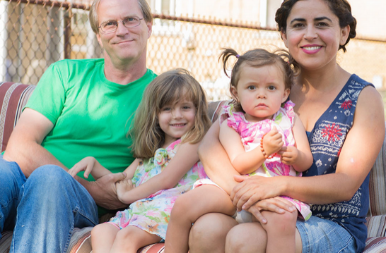
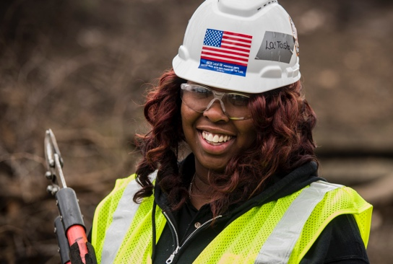
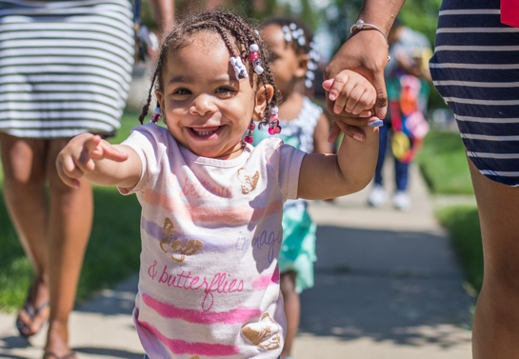
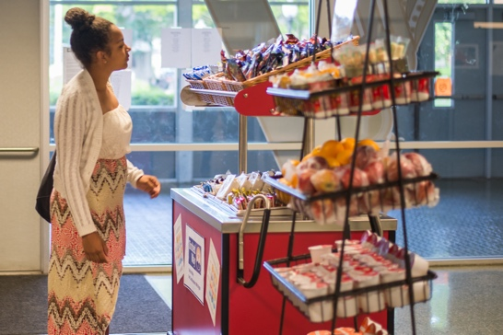
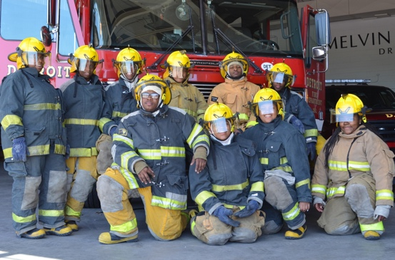
STORIES
HEALTH
“We want parents to be healthy role models."
— Lily Doher, Registered Dietitian, United Way
UnitedWaySEM.org/BuildingHealthyFamilies
ECONOMIC PROSPERITY
“Access for All sent me on my way with everything I needed.” — La’Tasha Smith, Access for All graduate
UnitedWaySEM.org/Access
EDUCATION
“It is absolutely wonderful, especially for micro-providers who need another ear or eye to run something past or who have another idea or another way of doing something."
— Lorna Parks, in-home child care provider
UnitedWaySEM.org/GreatStart
HEALTH
“We believe we’re saving lives.” — Matthew Dailey, Hazel Park High School Principal
UnitedWaySEM.org/Breakfast
EDUCATION
“This program is so much more than just firefighting. When you’re in a firehouse, you’re part of a family. I love being able to just share that sense of family and caring about the individuals in your household, because it is a second home for us.” — Detroit Fire Department Lt. Anthony Watts, College and Career Pathways teacher
UnitedWaySEM.org/PreparingTheFuture
UNITED WAY FOR SOUTHEASTERN MICHIGAN

Slide 11
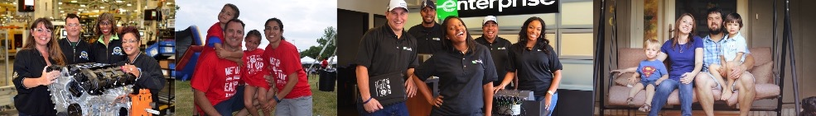
GET INVOLVED
GIVE • ADVOCATE • VOLUNTEER
UnitedWaySEM.org
UNITED WAY FOR SOUTHEASTERN MICHIGAN

Slide 12
YOUR DOLLARS MAKE A DIFFERENCE
As a member of our donor network, your dollars support
vital programs, smart policy reform and volunteer opportunities.
FUEL A CHILD’S SUMMER
Fund a week of physical activity for kids at a Meet Up and Eat Up summer meal site by donating $5 per paycheck for a year (equivalent to the cost of a cup of coffee).
SET THE STAGE FOR SUCCESS
Support 52 calls to our 2-1-1 help line by donating $10 per paycheck for a year (equivalent to the cost of a movie ticket). Your gift provides vital referral resources to food pantries, shelter, job training and more.
DELIVER AT TAX TIME
By giving $20 per paycheck for a year
(equivalent to the cost of a restaurant tab), you
can support nine households who take part in free tax return services and help qualifying working families keep more of what they earn.
UNITED WAY FOR SOUTHEASTERN MICHIGAN

Slide 13
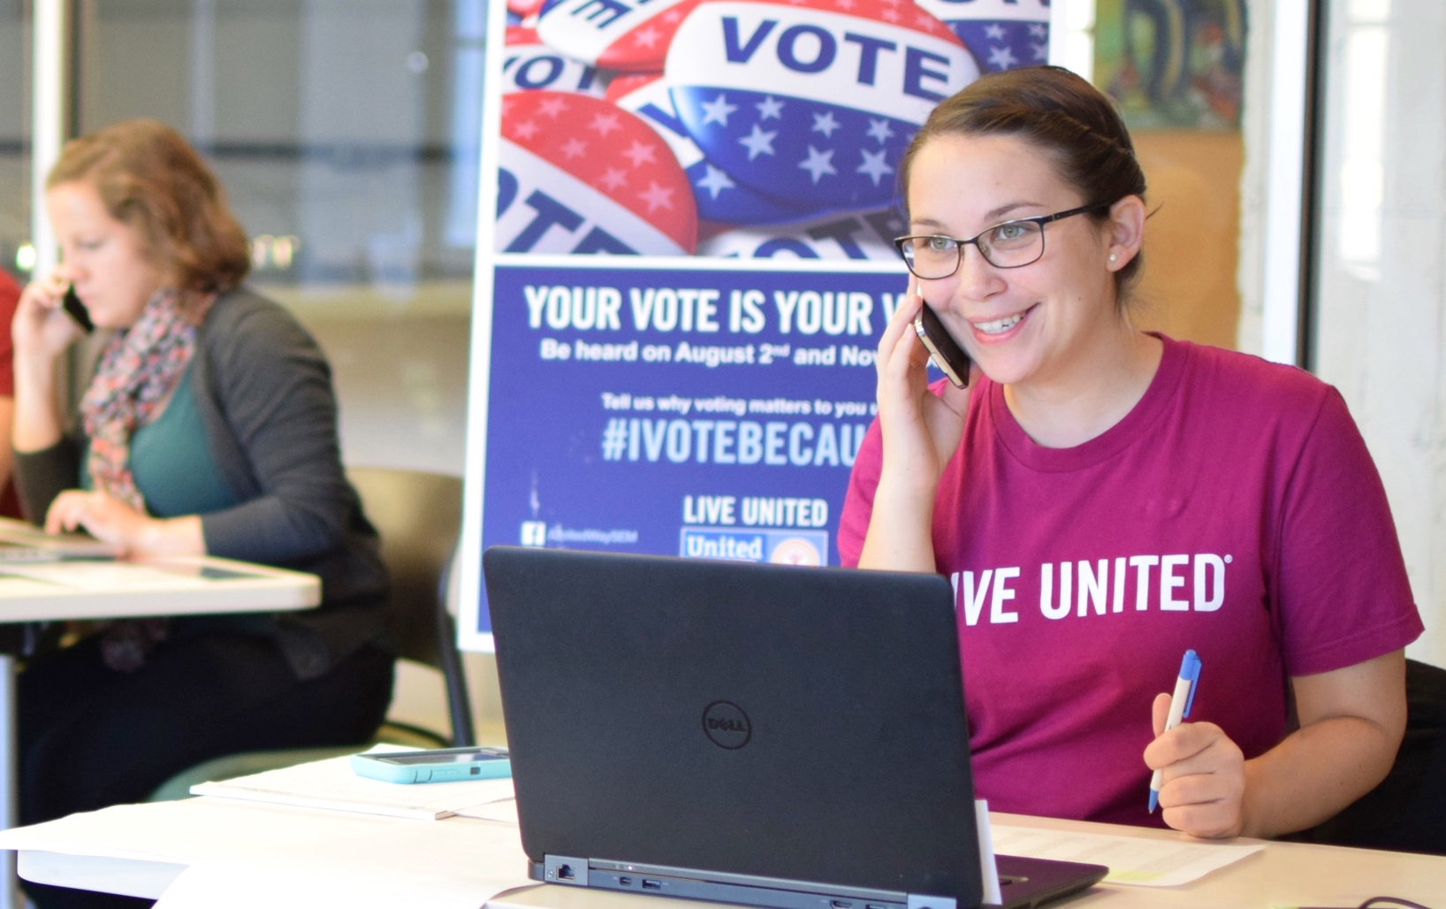
ADVOCATE FOR UNITED WAY
When you advocate with United Way, lawmakers take notice. We rally our partners and supporters to advance the United Way mission by advocating for meaningful change at the local, state and national levels.
Stay up to date and take action through our advocacy alerts: UnitedWaySEM.org/AdvocacyAlerts
UNITED WAY FOR SOUTHEASTERN MICHIGAN

Slide 14
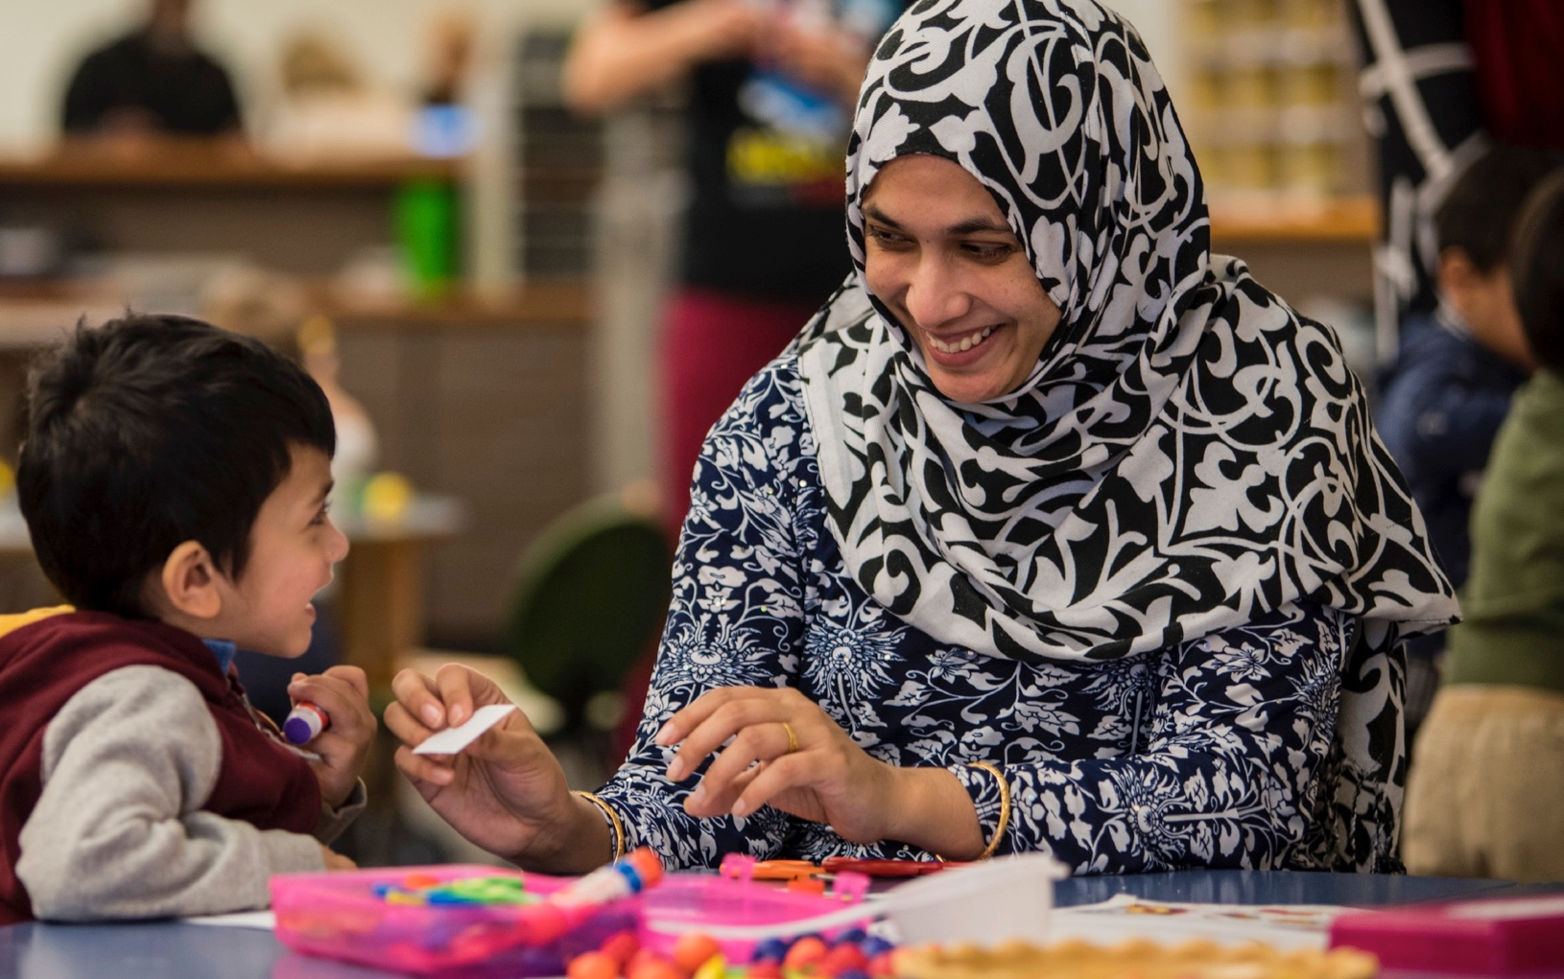
VOLUNTEER WITH UNITED WAY
Our volunteers are passionate about the community. Whether you give an hour, a Saturday or one day a week, your time makes a difference.
Visit our online portal to find the opportunity that fits you perfectly: UnitedWaySEM.org/volunteer
UNITED WAY FOR SOUTHEASTERN MICHIGAN

Slide 15
(COMPANY NAME) UNITED WAY HISTORY
This is the place to include information regarding your company’s involvement and history with United Way.
• Include narrative bullets
• History of the relationship
• Past giving history
• Campaign highlights
UNITED WAY FOR SOUTHEASTERN MICHIGAN

Slide 16
2018-19 CAMPAIGN DATES
This is a place to communicate information regarding events surrounding your company’s United Way campaign, including the start and end date.
• Campaign kickoff
• Bake sale
• Ice cream social
• Campaign end
UNITED WAY FOR SOUTHEASTERN MICHIGAN

Slide 17
2018-19 CAMPAIGN CHAIRPERSON
Introduce the person(s) that will be leading your company’s campaign efforts.
• Name
• Title
• Division
• Phone number
• Email
UNITED WAY FOR SOUTHEASTERN MICHIGAN

Slide 18
2018-19 CAMPAIGN GOALS
Enter your campaign goal(s). Goal(s) could be based on % of participation, overall dollars raised, average gift, Leadership Giving, etc.
• 2017 Participation: XX%
• 2018 Participation goal: XX%
• 2017 Average gift: $XXX
• 2018 Average gift goal: $XXX
UNITED WAY FOR SOUTHEASTERN MICHIGAN

Slide 19

THANK YOU!
UNITED WAY FOR SOUTHEASTERN MICHIGAN

